Slide 1
Designing for failure: Architecting resilient systems on AWS
ARC335-R
Adrian Cockcroft
Harsha Nippani
Pawan Agnihotri
VP, Cloud Architecture
Amazon Web Services Inc.
Solutions Architect
Amazon Web Services Inc.
Sr. Manager, Solution Architecture
Amazon Web Services Inc.

Slide 2
Agenda
Risk and Resiliency
Technical Considerations
Continuous Resilience
AWS Whitepaper

Slide 3
Risk and Resiliency
Notes:
Several industries like Financial Services have stringent requirements

Slide 4

Business continuity
How much data can you afford to recreate or lose?
How quickly must you recover?
What is the cost of downtime?
Disaster
Recovery point (RPO)
Recovery time (RTO)
Data loss
Down time
It’s not about the data, it’s about the mission

Slide 5
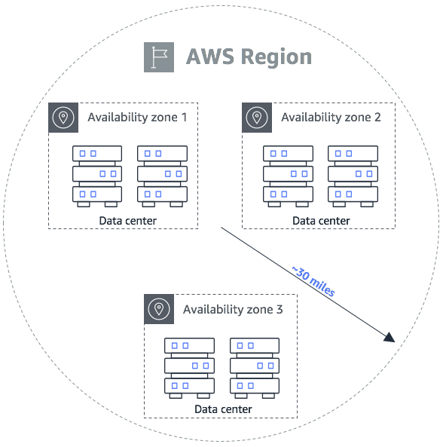
Resilient AWS Infrastructure
Infrastructure
Regions, AZs, Networking
Service Design
Cell-based architecture
Multi-Az architecture
Micro-service architecture
Distributed systems best practices
Understand the AWS Services scope
Single AZ, Regional, Global, Cross-Reginal capability
Figure 3
Notes:
Now lets look at the AWS infrastructure.
AWS provides a highly reliable, scalable, low-cost infrastructure platform in the cloud that powers hundreds of thousands of businesses in 190 countries around the world.
Each AWS Region is a separate geographic area where cloud resources can be instantiated. Regions are isolated from each other, meaning that a disruption in one Region does not result in contagion in other Regions. This achieves the greatest possible fault tolerance and stability.
Regions are designed to be autonomous, with dedicated copies of services deployed in each Region.
Each AWS Region has multiple Availability Zones (AZs). An Availability Zone is a collection of one or more data centers which forms a campus. AZs are physically separated and independent, and are built with highly redundant networking.
AWS employs multiple application design constructs with different levels of independent, redundant components, to make services highly resilient and reliable.
Detailed best practices for designing applications for high availability in the cloud can be found in the reliability pillar of the AWS Well-Architected Framework. https://d1.awsstatic.com/whitepapers/architecture/AWS-Reliability-Pillar.pdf
Explain…
Fault isolation zones
Cell-based architecture
Multi AZ architecture
Micro-services architecture
Redundant components
Recovery-Oriented Computing (ROC)
Distributed systems best practices, including:
Throttling
Retry with exponential back off
Fail fast (load shedding)
Use of idempotency tokens
Constant work
Circuit breaker
Static stability
Figure 3

Slide 6
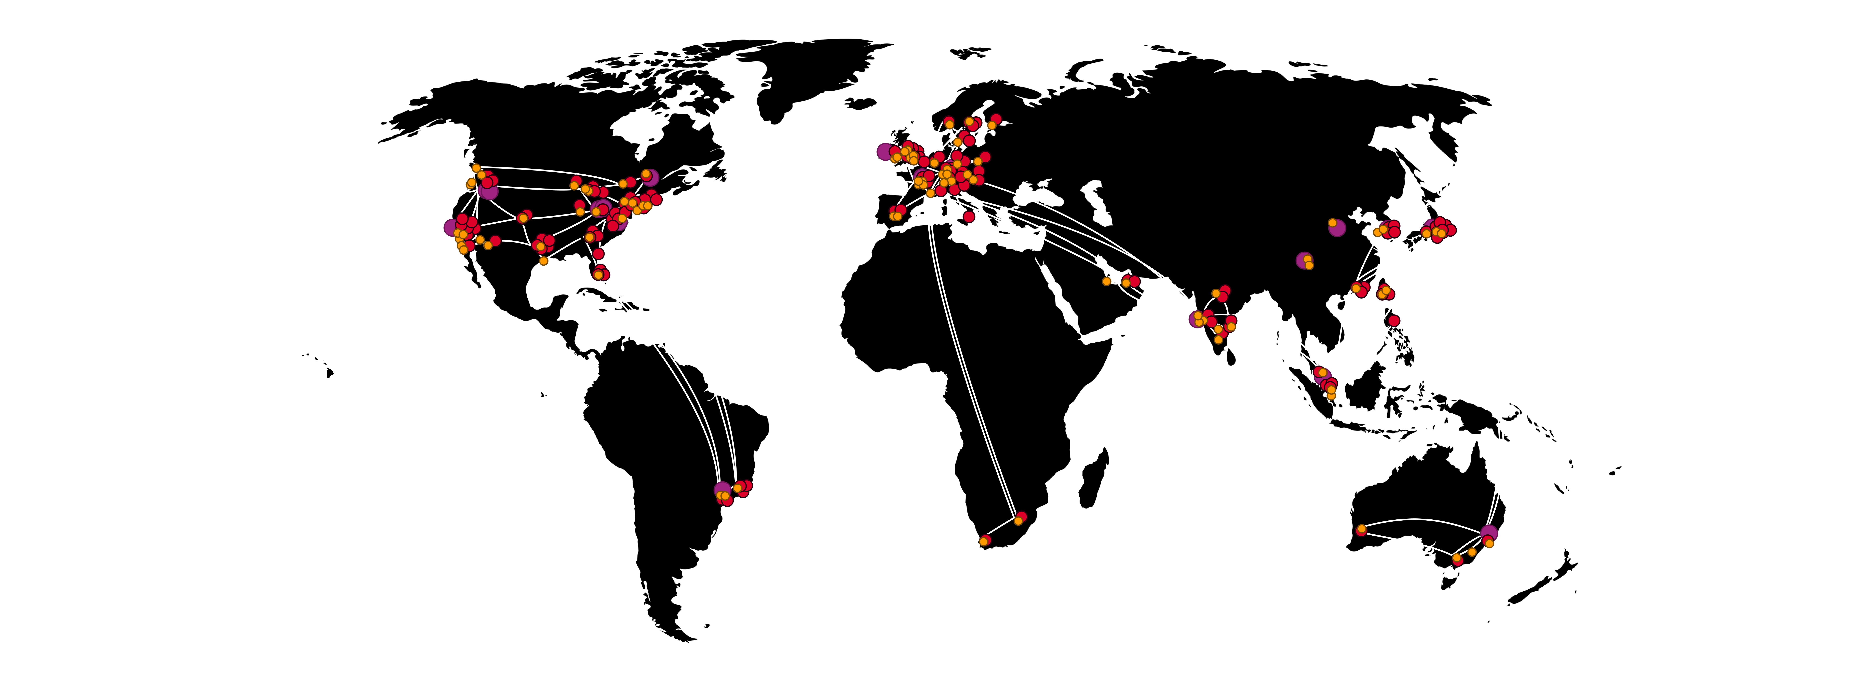
AWS CONNECTIVITY OPTIONS
96 AWS Direct Connect locations
Amazon Global Network
Customers can reach every public AWS Region from
the local Direct Connect location (except China)
AWS Region with Multiple Edge Locations
Amazon CloudFront PoPs
AWS Direct Connect Location
Notes:
AWS provides global connectivity options with a direct connect network of 94 locations around the world.
The global network of AWS Points of Presence (PoPs) (edge locations and regional edge caches) currently consists of 169 PoPs in 68 cities across 29 countries, including locations in the United States, Canada, Europe, Africa, Asia, Australia, and South America—all continents excluding Antarctica.
Storyline
Encryption
Managed by one company - Amazon.
Every fiber is redundant 100G.
Operated under various models - dark fiber under indefeasible right of use (IRU) and our own cabling - transoceanic.
Global Direct Connect network consists of 94 locations around the world.
The global network of AWS Points of Presence (PoPs) (edge locations and regional edge caches) currently consists of 144 PoPs in 65 cities across 29 countries, including locations in the United States, Canada, Europe, Africa, Asia, Australia, and South America—all continents excluding Antarctica.
RFP LANGUAGE: Our computing and storage services are globally accessible regardless of location and connectivity status, at all classification levels. We provide sure access to our computing and storage resources and enable interoperability between virtual enclaves containing applications and data.
Key Differentiators
Direct Connect Gateway
Volume of connecting locations
FUD Elimination
Demo Element

Slide 7
The four strategies for business continuity (Multi-Region)
Backup & Restore
Pilot
Light
Warm Standby
Active-Active
AWS Multi-Region

Slide 8




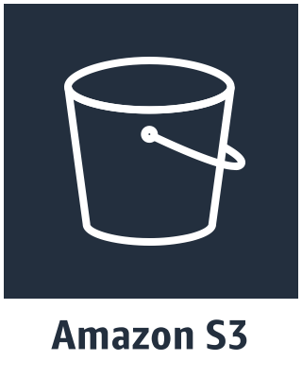
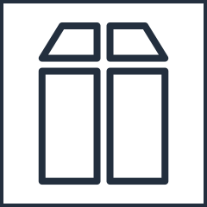
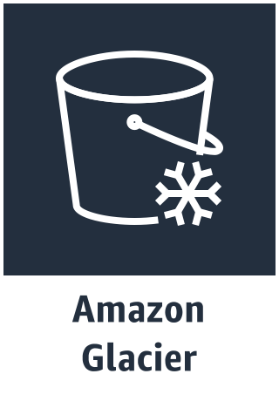
Strategy: Backup & restore (multi-region)
us-west-2
App2
Server
App3
Server
Database
Server
App1
Server
Backup to another region
Use managed database services with Amazon Simple Storage Service
(Amazon S3) or Amazon Glacier
Data stored with high durability in multiple locations
Backup Server
ap-southeast-1
Down time (RTO)
Data loss (RPO)

Slide 9






Strategy: Pilot light (multi-region)
Allows the scaling of redundant sites during a failure scenario
us-west-2
ap-southeast-1
Web
Server
Web Server
Snapshots
AMIs:
Web, App, Database
Snapshots
AMIs:
Web, App, Database
App1
Server
App2
Server
App3
Server
App1 Server
App2
Server
App3 Server
Snapshots
Replication
Database Master
Database Replica
Database
Replication
Down time (RTO)
Data loss (RPO)

Slide 10
Strategy: Pilot light (multi-region)
Allows the scaling of redundant sites during a failure scenario
us-west-2
ap-southeast-1
Web Server
Web Server
App1 Server
App2
Server
Snapshots
AMIs:
Web, App, Database
App2
Server
Snapshots
AMIs:
Web, App, Database
App3 Server
App2 Server
Database Master
Database Master
Down time (RTO)
Data loss (RPO)

Slide 11
Strategy: Warm Standby (Multi-Region)
us-west-2
ap-southeast-1
Web Server
Web Server
App1 Server
App2
Server
App3 Server
Snapshots
AMIs:
Web, App, Database
Snapshots
AMIs:
Web, App, Database
App1 Server
App2
Server
App3 Server
Snapshots
Replication
Database Master
Database Replica
Database
Replication
Down time (RTO)
Data loss (RPO)

Slide 12
Strategy: Warm standby (multi-region)
us-west-2
ap-southeast-1
Web Server
Web Server
App1 Server
App2
Server
App3 Server
Snapshots
AMIs:
Web, App, Database
App1 Server
App2
Server
App3 Server
Snapshots
AMIs:
Web, App, Database
Database Master
Database Master
Down time (RTO)
Data loss (RPO)

Slide 13



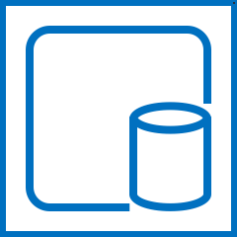
Strategy: Active-Active (Multi-Region)
Users in
San Francisco
Users in
Taipei
read
read
& write
write
us-west-2
ap-southeast-1
Web Server
Web Server
App1 Server
App2
Server
App3 Server
Snapshots
Replication
Snapshots
AMIs:
Web, App, Database
App1 Server
App2
Server
App3 Server
Snapshots
AMIs:
Web, App, Database
Database Master
Database Replica
Database
Replication

Slide 14
Technical Considerations (Data and Network)

Slide 15
Amazon Simple Storage Service (S3) - Cross-Region Replication
Flexibility to replicate data:
At the bucket, prefix, or object level NEW!
From any region to any region
To any storage class NEW!
Across AWS accounts
Change the object owner in the destination region
US East
(Ohio)
AZ2
AZ2
Asia Pacific
(Sydney)
AZ1
AZ1
AZ3
AZ3
Any S3 Storage Class
Any S3 Storage Class

Slide 16



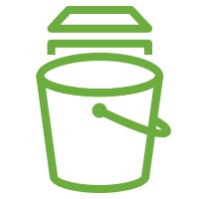
Amazon Elastic Block Store (EBS) snapshots
Elastic block storage
Point-in-time backup of modified volume blocks
Stored in S3, accessed via Amazon EBS APIs
Subsequent snapshots are incremental
Deleting snapshot will only remove data exclusive to that snapshot
Copies in same region or cross region
EBS Volume
EBS snapshot

Slide 17




EBS Volume – Cross Region snapshot copy
EBS volume
EC2 instance
EBS volume
EC2 instance
Availability Zone
Availability Zone
Amazon S3
EBS snapshot
EBS snapshot
AWS Region 1
AWS Region 2

Slide 18
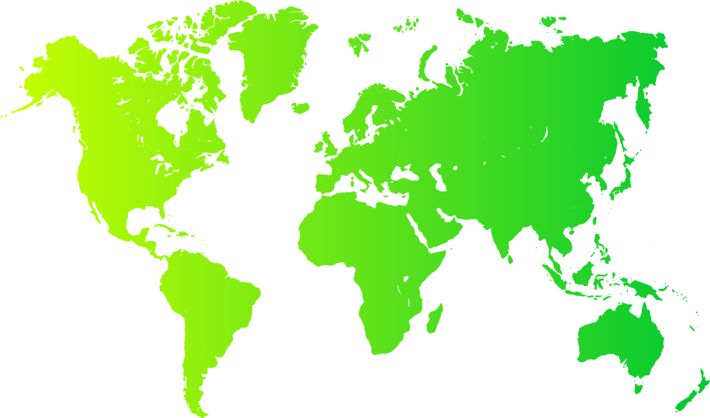

Amazon DynamoDB global tables Fully managed, multi-master, multi-region database
Build high performance, globally distributed applications
Low latency reads & writes to locally available tables
Disaster proof with multi-region redundancy
Easy to setup and no application re-writes required

Slide 19


Cross-region read replicas with Amazon Relational Database Service (RDS) and Amazon Aurora
Region A
Region B
Availability zone 1
Availability zone 2
Availability zone 3
Availability zone 1
Availability zone 2
Availability zone 3
Application
Application
Application
Application
Application
Application
RO
RO
RW
RW
RO
RO
RO
Aurora Storage
Replication Servers
Replication Agents
Aurora Storage

Slide 20
Inter-Region Virtual Private Cloud (VPC) Peering
Inter-Region Virtual Private Cloud (VPC) Peering
Why is this important to my architecture?

Slide 21


Inter-Region VPC Peering
us-west-2
ap-southeast-1
VPC
VPC
AMAZON BACKBONE
VPC PEER
App1 Server
App2
Server
App3 Server
App1 Server
App2
Server
App3 Server
Database
Database

Slide 22

Multi-region multi-VPC connectivity
us-west-2
ap-southeast-1
VPC
VPC
VPC
Shared
Services
VPC
VPC
Shared
Services
VPC
AMAZON BACKBONE
VPC PEER
VPC
VPC
VPC
VPC

Slide 23











AWS Cloud
Ingress/ egress
Internet
US-East-1 (N. Virginia)
Transit Hub VPC w/ CSR
(egress control + IGW)
Ingress / egress
Direct Connect (colo)
Customer Data Center
(Primary)
Transit Gateway
DX Gateway
Workload VPC
(No IGW)
10g DX Conn
CGW
Workload VPC
(No IGW)
Transit VIF
Dual Links
Shared Services
(No IGW)
Cross Region VPC Peering
US-East-2 (Ohio)
Shared Services
(No IGW)
Direct Connect (colo)
Customer Data Center
(DR Site)
Transit Gateway
DX Gateway
Workload VPC
(No IGW)
10g DX Conn
CGW
Workload VPC
(No IGW)
Transit VIF
Dual Links
Transit Hub VPC w/ CSR
(egress control + IGW)

Slide 24
Continuous Resilience

Slide 25
Datacenter to cloud migrations are under-way for the most business and safety critical workloads
AWS and our partners are developing patterns, solutions and services for customers in all industries including travel, finance, healthcare, manufacturing…

Slide 26
Resilience
Past
Present
Future
?
Disaster recovery
Chaos engineering
Continuous
Resilience

Slide 27
“If we change the name from chaos engineering to continuous resilience, will you let us do it all the time in production?”
Blog post: Failure Modes and Continuous Resilience - medium.com/@adrianco

Slide 28
You can only be as strong as your weakest link
Dedicated teams are needed to find weaknesses before they take you out!

Slide 29
Availability, Safety and Security have similar characteristics
Hard to measure near misses
Hard to model complex dependencies
Catastrophic failure modes

Slide 30
Availability, Safety and Security have similar mitigations
Layered defense in depth
Bulkheads to contain blast radius
Minimize dependencies/privilege

Slide 31
Availability, Safety and Security Break Each Other
Security breaks availability
Availability breaks safety
Etc.

Slide 32
What should your system do when something fails?
Stop?
Carry on with reduced functionality?
Collapse horribly?

Slide 33
What should your system do when something fails?
Permissive failure, what’s the real cost of continuing?
If a permissions look up fails, should you stop or continue?
See Memories, Guesses, and Apologies by Pat Helland

Slide 34
If a permissions look up fails, should you stop or continue?
Do you have a backup datacenter?
How often do you failover apps to it?
How often do you failover the whole datacenter at once?
“Availability Theater”

Slide 35
A fairy tale…
Once upon a time, in theory, if everything works perfectly, we have a plan to survive the disasters we thought of in advance.
How did that work out?

Slide 36
Forgot to renew domain name…
SaaS vendor
Entertainment site
Didn’t update security certificate and it expired…
Datacenter flooded in hurricane Sandy…
Finance company, Jersey City
Whoops!
YOU, tomorrow

Slide 37
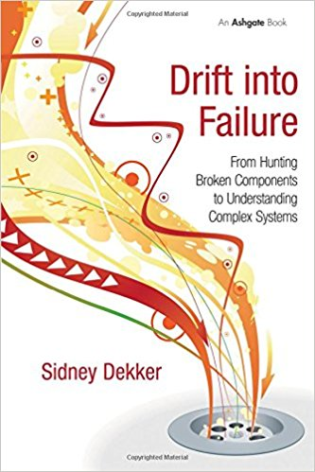
Drift into Failure
Sydney Dekker
Everyone can locally optimize for the right outcome at every step, and you may still get a catastrophic failure as a result…
We need to capture and learn from near misses, test and measure the safety margins, before things go wrong.

Slide 38
Chaos
architecture
People
Application
Four layers
Two teams
An attitude—
Find the weakest link
Tools
Tools
Chaos Engineering Team
Security Red Team
Switching
Infrastructure

Slide 39
Defense In Depth
Experienced staff
Robust applications
Dependable switching fabric
Redundant service foundation

Slide 40
“You can’t legislate against failure, focus on fast detection and response.”
—Chris Pinkham

Slide 41
Engineering a Safer World Systems Thinking Applied to Safety
Nancy G. Leveson
STPA – Systems Theoretic Process Analysis
STAMP – Systems Theoretic Accident Model & Processes
http://psas.scripts.mit.edu for handbook and talks

Slide 42
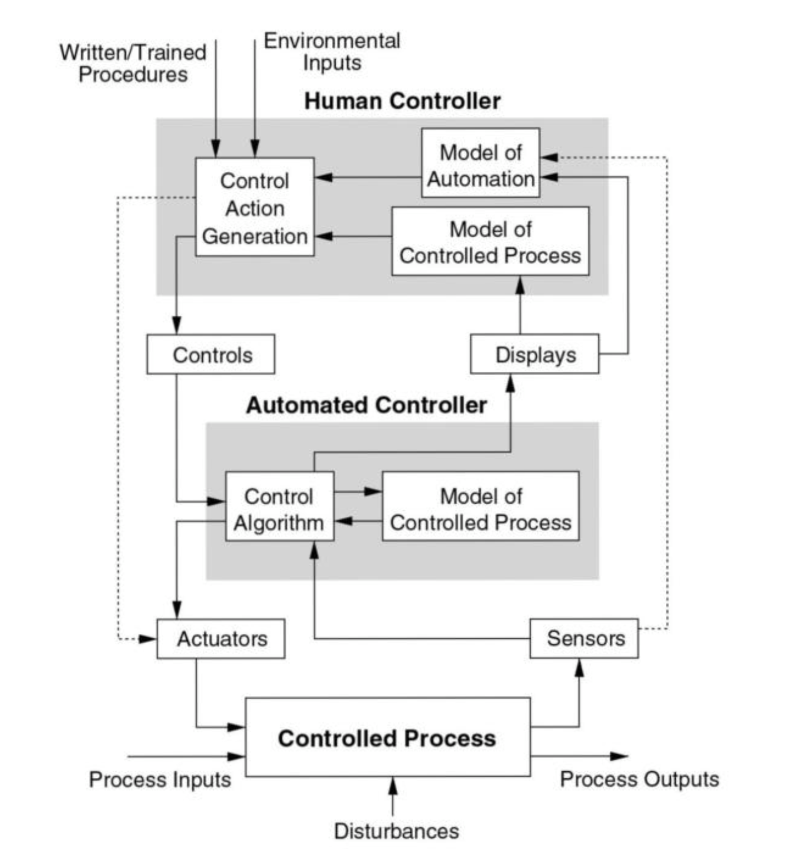


Observability
STPA Model
(System Theoretic Process Analysis)
Epidemic failure modes
Automation and continuous chaos

Slide 43
Throughput
Observability
STPA Model
Understand Hazards that could disrupt successful application processing
Control Plane
Epidemic failure modes
Automation and continuous chaos
Data Plane
Financial Services App
Customer requests
Completed actions

Slide 44
Throughput
STPA Hazards
Human Control Action:
Not provided
Unsafe action
Safe but too early
Safe but too late
Wrong sequence
Stopped too soon
Applied too long
Conflicts
Coordination problems
Degradation over time
Control Plane
Epidemic failure modes
Automation and continuous chaos
Data Plane
Financial Services App
Customer requests
Completed actions

Slide 45
Throughput
STPA Hazards
Sensor Metrics:
Missing updates
Zeroed
Overflowed
Corrupted
Out of order
Updates too rapid
Updates infrequent
Updates delayed
Coordination problems
Degradation over time
Control Plane
Epidemic failure modes
Automation and continuous chaos
Data Plane
Financial Services App
Customer requests
Completed actions

Slide 46
Throughput
STPA Hazards
Model problems:
Model mismatch
Missing inputs
Missing updates
Updates too rapid
Updates infrequent
Updates delayed
Coordination problems
Degradation over time
Control Plane
Epidemic failure modes
Automation and continuous chaos
Data Plane
Financial Services App
Customer requests
Completed actions

Slide 47
Cloud provides the automation that leads to chaos engineering

Slide 48
Good Cloud Resilience Practices
Rule of 3 – three ways for critical operations to succeed
Synchronous data replication over three zones in a region
DR failover from primary region to either of two secondary regions
Active-Active-Active workloads across three regions

Slide 49
Good Cloud Resilience Practices
Fail up - DR failover between regions
From smaller capacity region to larger capacity region
From distant region to closer (lower latency) region

Slide 50
Good Cloud Resilience Practices
Chaos first
Build your resilience environment before introducing apps to it
Automated continuous zone and region failover testing
Make it a “badge of honor” to have an app pass the chaos test

Slide 51
Good Cloud Resilience Practices
Continuous Resilience
Continuous Delivery needs Test Driven Development and Canaries
Continuous Resilience needs automation in both test and production
Make failure mitigation into a well tested code path and process
Call it Chaos Engineering if you like, it’s the same thing…

Slide 52
As datacenters migrate to cloud, fragile and manual disaster recovery processes can be standardized and automated

Slide 53

Testing failure mitigation will move from a scary annual experience to automated continuous resilience
Time to Value
Distributed Optimized Capacity

Slide 54


Continuous Resilience
Paper: Building Mission Critical Financial Services Applications on AWS
By Pawan Agnihotri with contributions by Adrian Cockcroft
Blog post: Failure Modes and Continuous Resilience - medium.com/@adrianco
Adrian Cockcroft
@adrianco
AWS VP Cloud Architecture Strategy

